Slide 1
Computer Organization and Architecture
MIPS Architecture
Lecture: 03
Fall, 2020

Slide 2
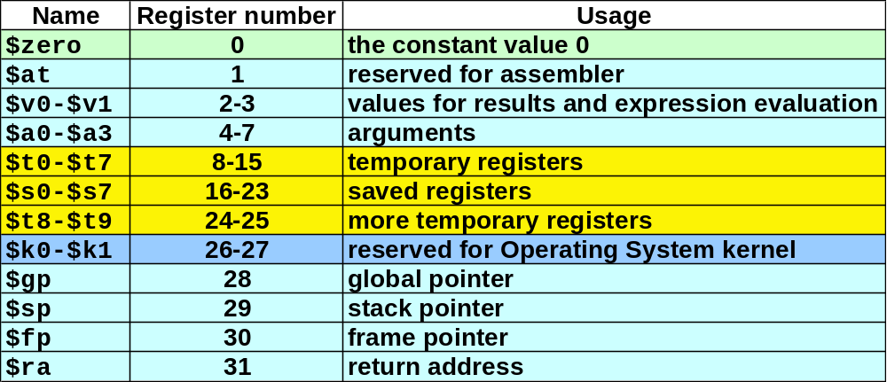
MIPS Registers and Usage
Each register can be referred to by number or name.

Slide 3
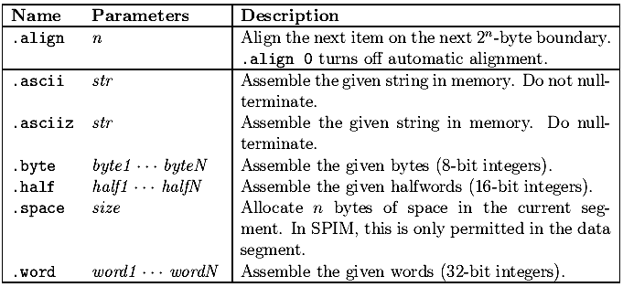

Slide 4
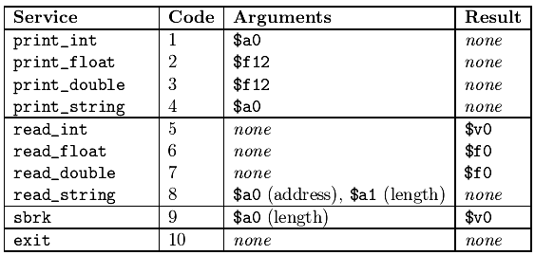
Syscall

Slide 5
Home task
and and $1,$2,$3 $1 = $2 & $3 Bitwise AND
or or $1,$2,$3 $1 = $2 | $3 Bitwise OR
xor xor $1,$2,$3 $1 = $2 ??$3 Bitwise XOR
nor nor $1,$2,$3 $1 = ~($2 | $3) Bitwise NOR
and immediate andi $1,$2,10 $1 = $2 & 10 Bitwise AND reg, const
or immediate ori $1,$2,10 $1 = $2 | 10 Bitwise OR reg, const
xor immediate xori $1, $2,10 $1 = ~$2 &~10 Bitwise XOR reg, const
shift left logical sll $1,$2,10 $1 = $2 << 10 Shift left by constant
shift right logical srl $1,$2,10 $1 = $2 >> 10 Shift right by constant
shift right arithm. sra $1,$2,10 $1 = $2 >> 10 Shift right (sign extend)
shift left logical sllv $1,$2,$3 $1 = $2 << $3 Shift left by var
shift right logical srlv $1,$2, $3 $1 = $2 >> $3 Shift right by var
shift right arithm. srav $1,$2, $3 $1 = $2 >> $3 Shift right arith. by var

Slide 6
Home task
blt $t0, $t1, Lab1 # Branch if $t0 < $t1
ble $t0, $t1, Lab2 # Branch if $t0 <= $t1
bgt $t0, $t1, Lab3 # Branch if $t0 > $t1
bge $t0, $t1, Lab4 # Branch if $t0 >= $t1

Slide 7
MIPS addressing modes
Addressing modes are the ways of specifying an operand or a memory address.
Register addressing
Operands are in a register.
Example: add $3,$4,$5
Takes n bits to address 2^{n} registers
op | rs | rt | rd | shamt | funct

Slide 8
R-format Instructions
Have op 0. (all of them!)
    rs: 1st register operand (register source) (5 bits)
    rt: 2nd register operand (5 bits)
    rd: register destination (5 bits)
    shamt: shift amount (0 when N/A) (5 bits)
    funct: function code (identifies the specific R-format instruction) (6 bits)

Slide 9
Register addressing
op
rs
rt
rd
shamt
funct
memory
ALU
registers

Slide 10
Instructions
MULT and MUL instruction Comparison
mult $t0, $t1
Multiplies the two operands and store the 64-bit product hi-lo, i.e. its most significant 32 bits in hi
least-significant 32 bits in lo.
mul $t2, $t0, $t1
Multiplies the two operands and store it in $t2

Slide 11
Branch instruction
if ($t0 = = $t1)
{
Print ($t0 + $t1);
}
else
{
Print ($t0 - $t1);
}
Instruction
beq $t0, $t1, XX

Slide 12
Set less than (slt)
if ($t0 < $t1)
{
Print ($t0 + $t1);
}
else
{
Print ($t0 - $t1);
}
We can reduce a "less-than" test to a "not-equal" test by using the following instruction:
slt $t2, $t0, $t1
It sets $t2 to 1 if $t0 < $t1 and sets it to zero otherwise. Using this "set-on-less-than" instruction, you can perform the above test using bne

Slide 13
Task
Takes two numbers A and B from user, and prints out all the multiples of A from A to A * B.
Write the program that reads an integer x from the user and outputs 20x without using mul and mult. Note that you can rewrite 20x as a sum of two terms each of which multiplies x by a power of 2.

